Slide 1
Predicting Student Outcomes

Slide 2
Client Problem
Dropping out of high school carries a high cost to students
General ‘stay in school’ messaging is likely less effective than more targeted interventions
Schools and districts are under pressure to increase graduation rates
High dropout rates can hurt school climate and teacher morale

Slide 3
The Data Science Problem
We would like to classify students into ‘dropout’ and ‘non-dropout’ categories
We would like to assign a probability of dropout to each student.

Slide 4
Data Wrangling
Survey Data from the National Center for Education Statistics (NCES)
Longitudinal study of 2009-2016
Followed about 23,000 ninth graders starting in 2009 over seven years
Complex sample design was used to make sure that the survey population was represented of the US as a whole.
A version with certain data labeled ‘suppressed’ is freely available without permission
Data contained in several formats (like R and STATA), including CVS file
In addition to importing survey answers, also import weight columns
Also import documentation text which connects the numbers present in the data tables with the corresponding answers to survey questions

Slide 5
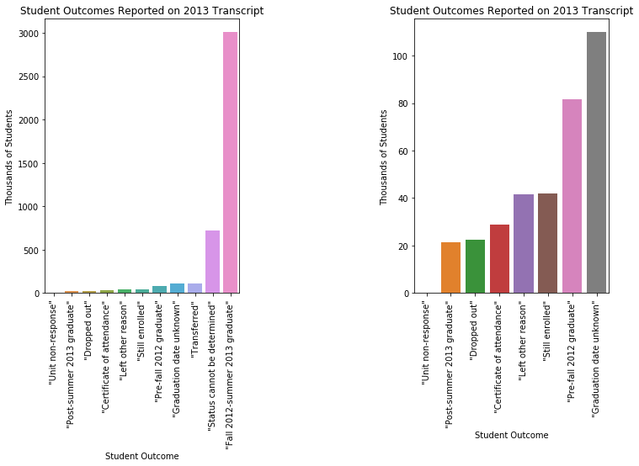
Exploratory Analysis
Outcomes as listed on student trascripts gives very rosy outlook.
Total students that end with ‘dropout’ on their transcript is 20 thousand out of about 4.2 million freshman.
Large number of ‘unknown status’ students

Slide 6
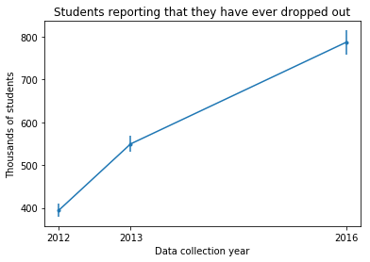
Exploratory Analysis
When we look at dropout as reported by students and parents, we see that a much greater number of students have dropped out
Starting with the original cohort’s junior year, we see that more students dropped out of high school each year.
We use the 2013 ‘have you ever dropped out of high school’ question as labels for dropout/non-dropout

Slide 7
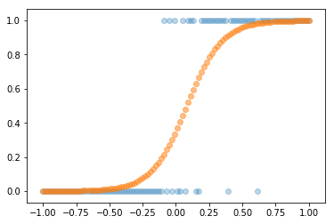
The Machine Learning Model - Logistic Regression
Logistic regression is a highly interpretable model, useful in categorization.
The model fits the given data using a logit function that takes on values ‘0’ and ‘1’, as well as values in between.
The coefficients created by the model are related to the change in the odds that the correct class is ‘1’ for a unit change in the dependent variable.

Slide 8
Logistic Regression - Continuous Data
Logistic regression can be used to model data that takes on two values.
When the independent variable is continuous, a smooth curve can be drawn.
The curve represents the probability that the correct class is ‘1’.

Slide 9
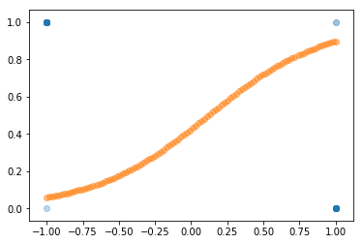
Logistic Regression - Discrete Data
Logistic regression can also model discrete data.
The model predicts the probability that each value of the independent variable is ‘1’.
The predicted probabilities for the independent variable no longer have meaning.

Slide 10
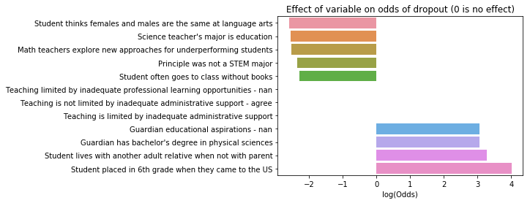
Results - Top positive and negative coefficients
as well as three neutral coefficients.

Slide 11
Results - Precision and Recall for different models
Model | Precision | Recall
Baseline | 0.32 | 0.40
Balanced Class Weights | 0.28 | 0.47
Random Undersampling | 0.20 | 0.62
Random Oversampling | 0.30 | 0.45
F1 Score Optimization | 0.56 | 0.29
Balanced Class weights and F1 Score Optimization | 0.27 | 0.69

Slide 12
Client Recommendations - Example: Recall 80%, Precision 25%
A school of 725 students will have approximately 100 potential dropouts
80% recall means that 80 out of the 100 dropouts are identified
25% precision means that 320 students are identified as potential dropouts
This is nearly 45% rather than 15% of the student population
This would be a good route for a school if the intervention were aimed at entire grades

Slide 13
Client Recommendations - Example: 50% Recall, 40% Precision
50% recall means that 50 out of 100 dropouts are identified
40% precision means that 125 students are identified as potential dropouts
These are more manageable numbers for a targeted intervention meant to treat students in small groups
An even more precise model would focus on a handful of students

Slide 14
Client Recommendations - Best of both worlds
We strongly recommend including humans as part of the workflow
Combining human scanning, and knowledge of students as individuals, achieves the best of both worlds
We can attempt a high recall model to narrow down the list of possible dropouts
Use teachers, counselors, and administrators familiar with the student to increase the precision

Slide 15
Future Improvements
Restricted Use Files
More detailed data
School level data as well as student level
Partner with schools and districts
Different Approach
Anomaly detection
Feature selection and interaction

